Slide 1
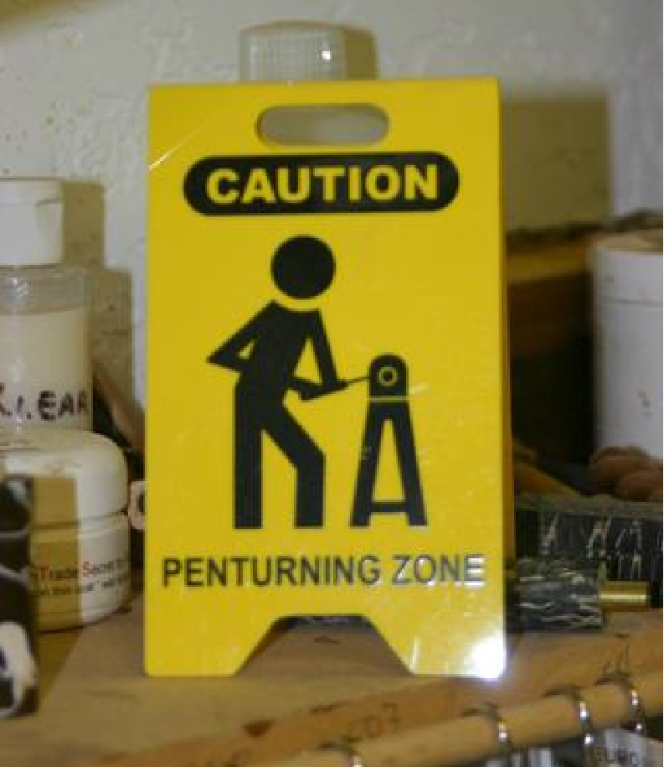

Slide 2
CLOSED END PENS
- Don Ward
Wichita Falls TX
RedRiverPens.com

Slide 3
What is a CLOSED END PEN
?
A closed end pen has
no terminal hardware
on either the BARREL end
or on the CAP
or BOTH

Slide 4
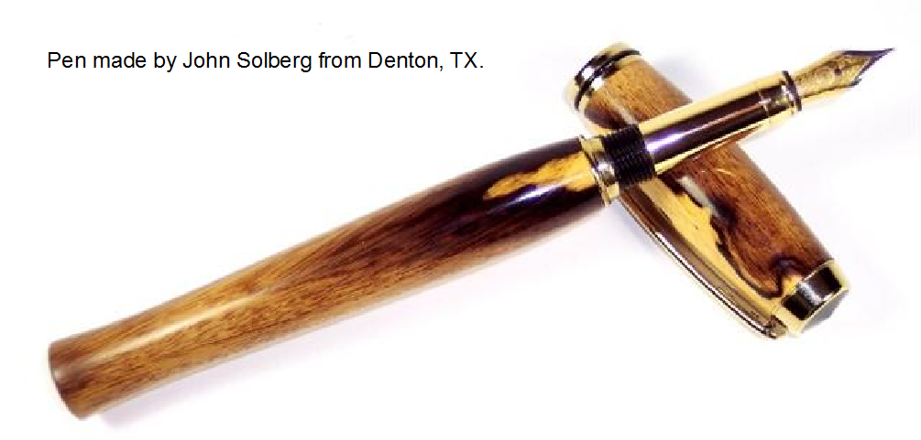
John Solberg
Denton TX

Slide 5
Don Ward
Wichita Falls TX
Kit: Penache,
fromCraft Supplies
Materials: Real cigar label under CA finish

Slide 6
Don Ward
Wichita Falls TX
Kit: Baron, aka: Navigator

Slide 7
Blank and pen made by
JeffinIndiana . . . Shop user name

Slide 8
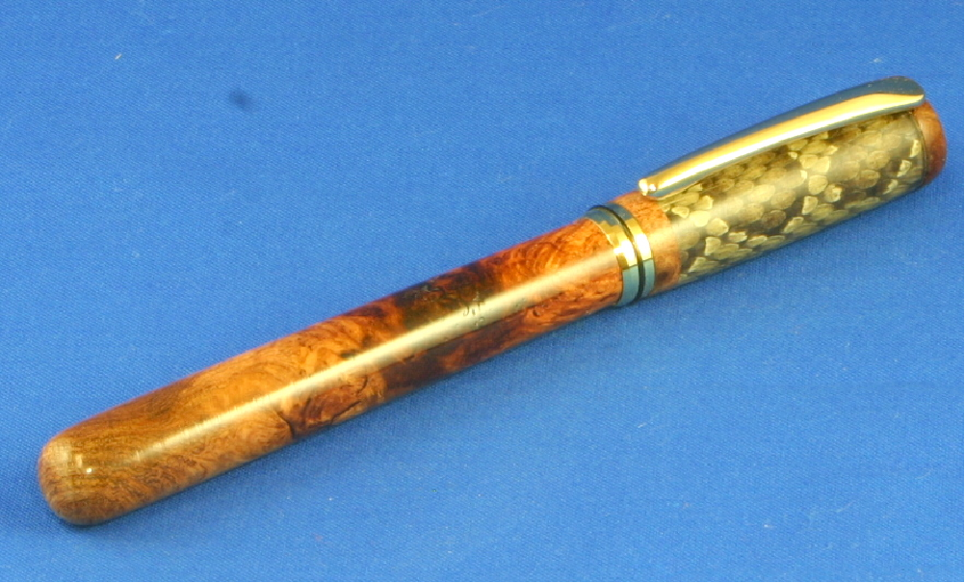
Mesquite and rattlesnake skin closed end Baron.
Pen & snake blank
- Don Ward Wichita Falls, Tx

Slide 9
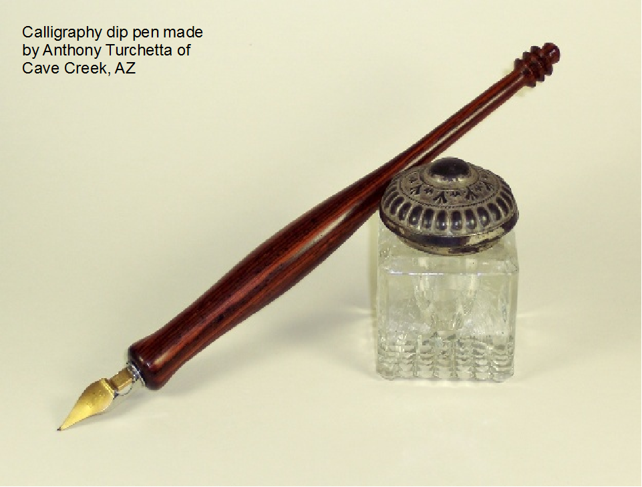
Calligraphy dip pen
John Solberg
Denton, TX

Slide 10
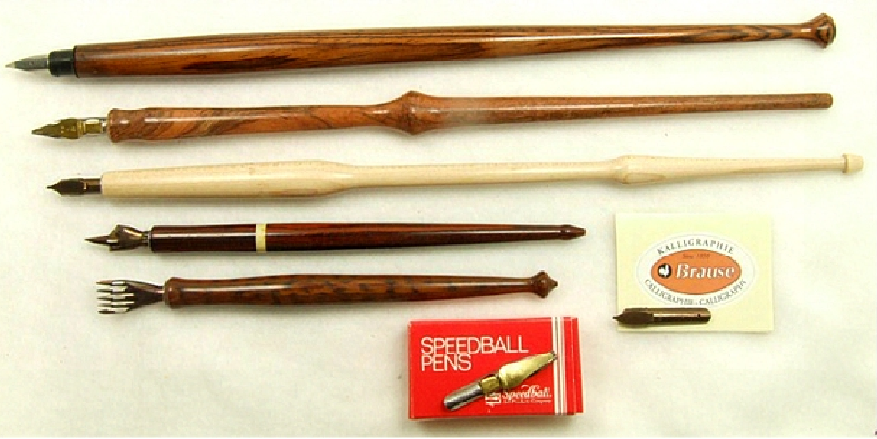
Calligraphy dip pens
Anthony Turchetta
Cave Creek AZ

Slide 11
Don Ward Wichita Falls TX
Kit: Baseball Bat Pen (discontinued)

Slide 12
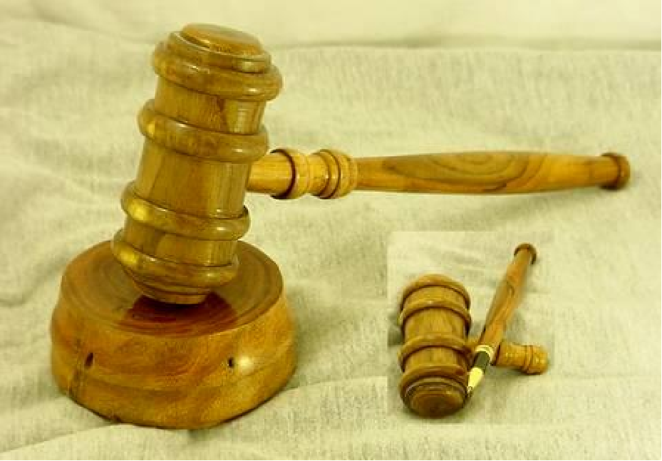
Full size gavel with a closed end pen made into the gavel's handle. The kit used was the Ameri-Classic rollerball. I've also use the executive kit has been used. I now use the Baron kit for the gavel pen.
-Don Ward using mesquite

Slide 13
Full size gavel with a closed end pen made into the gavel's handle. The kit used was the Ameri-Classic rollerball. I've also use the executive kit has been used. I now use the Baron kit for the gavel pen.
-Don Ward using mesquite

Slide 14
Desk pen
Don Ward Wichita Falls TX
Kit: Slimline modified as
closed end and extended
in length

Slide 15
Desk pen featured
in More Woodturning
Don Ward Wichita Falls TX
Kit: Baron aka Navigator
Wood: Mesquite

Slide 16
Just how is the penblank held, since the hole is not a through hole, but a blind hole which has no exit . . .
?

Slide 17
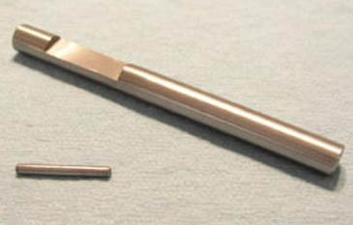
There are several ways to hold the blank. Tooling can be homemade or purchased.
One method is to use a pin chuck.

Slide 18
PIN
PEN TUBE
CHUCK
In a pin chuck the pin fits into a slot and the pen tube slides over the pen.
Slightly rotating the blank will cause the pin to grab the tube and hold the blank.
A pin chuck can be made in your shop.
I don't know anyone who is currently making them to be sold.

Slide 19
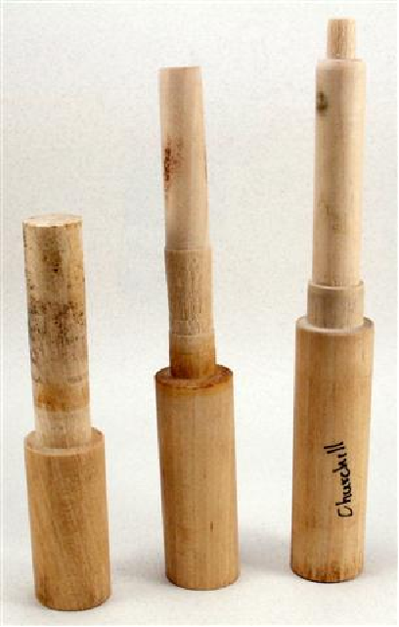
Homemade Jam chuck
The lower portion is shaped to fit the taper in the lathe headstock or it can be held in a Jacob's chuck or some other type of chucking system.

Slide 20
Homemade Jam chuck
The upper portion is made for the pentube to friction fit or jam fit to hold the blank.

Slide 21
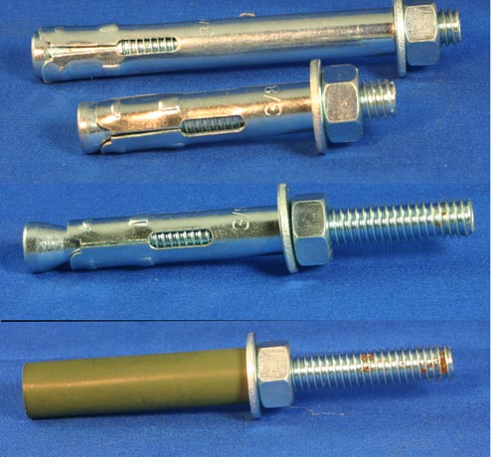
CONCRETE ANCHORS
Although not available in sizes that fit very many pen kit tubes, there are a few that will work.
A baron tube is shown
here and surprisingly
the one I tried ran
Truer than I thought
it would. There was
very little runout.

Slide 22
Commercially available
closed end pen mandrels:
from Arizona Silhouette in sizes
for several kits sold by them.
There is even a 7mm mandrel
which I used to make the 7mm
desk pen shown earlier.

Slide 23
There is a method to hold a blank with a blind hole for making closed end pens that requires no special tooling. All that is needed is a mandrel and bushings.

Slide 24
LET’S MAKE A PEN !

