Slide 1
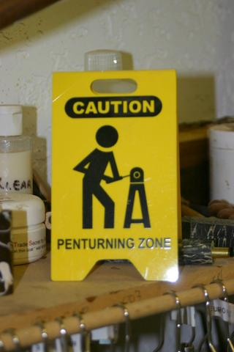

Slide 2
CASTING YOUR OWN BLANKS
ALL IMAGES and EMAIL SOURCES are used with permission

Slide 3
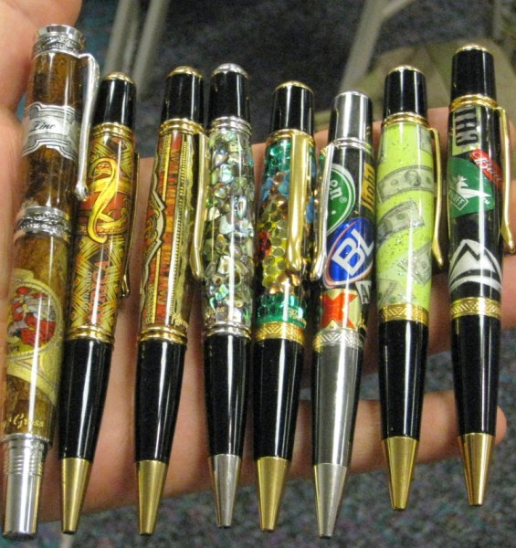

Slide 4
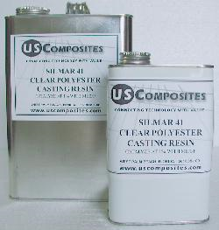
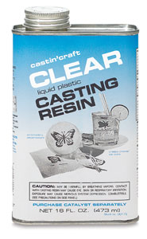
Silmar 41
Castin’ Craft
Two popular brands of polyester resin
are used to cast penblanks.

Slide 5
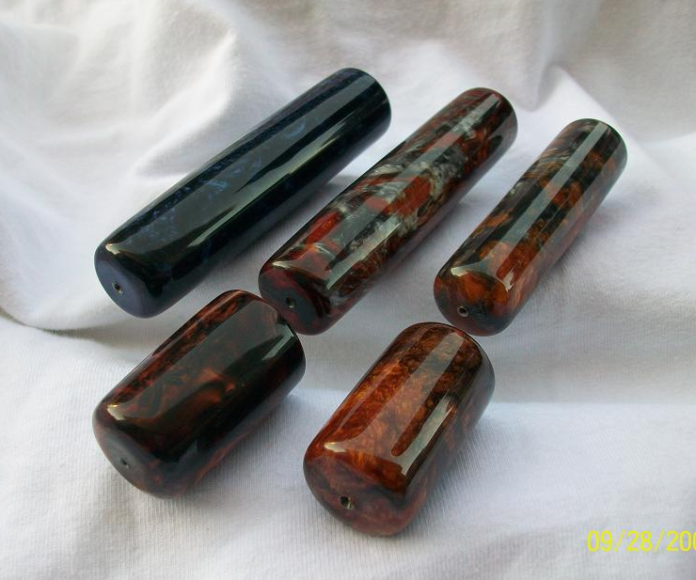
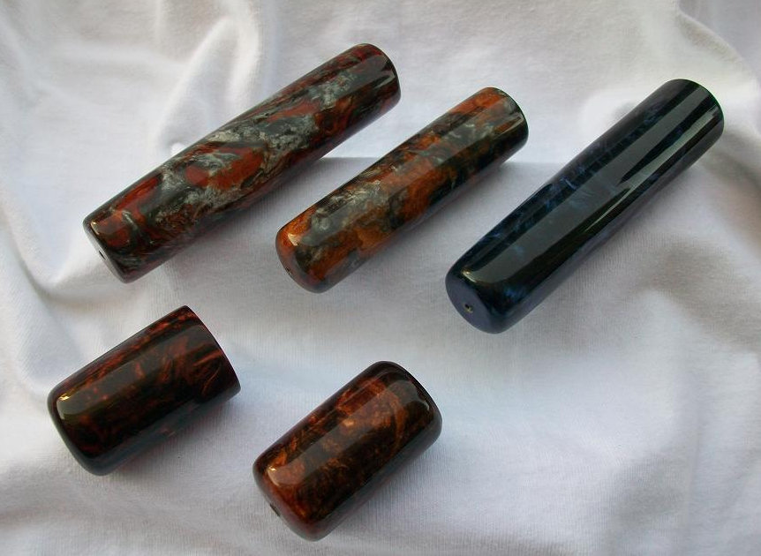
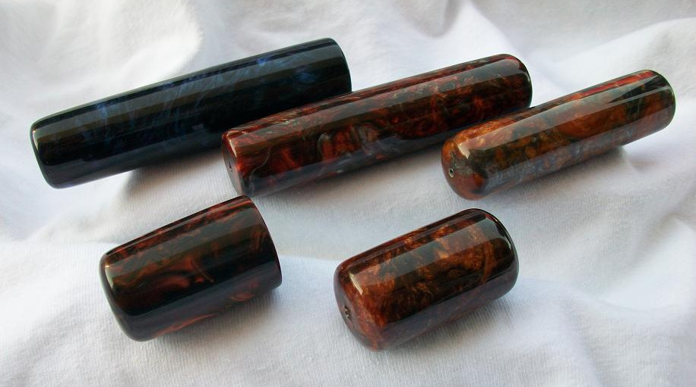
Acrylic type: polyester resin
These blanks and several other homemade and imported resins are available from Exotic Blanks at http://www.exoticblanks.com

Slide 6
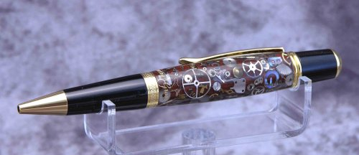
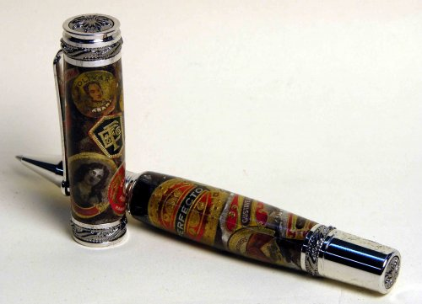
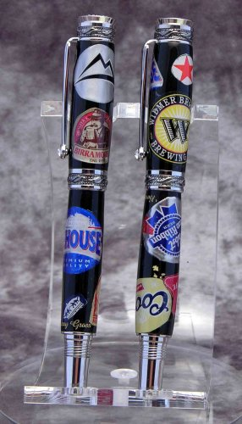
Acrylic type: polyester resin
Eco Friendly© blanks (©2008 BG Artforms)
Beer caps, cigar labels, watch parts
Blanks and Pens by Barry Gross
http://www.bgartforms.com

Slide 7
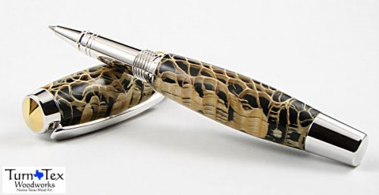
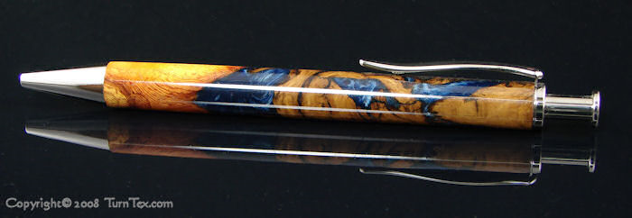
Cactus skeleton and wood pieces
Acrylic type:
Alumilite
Blanks and pens made by Curtis Seebeck

Slide 8
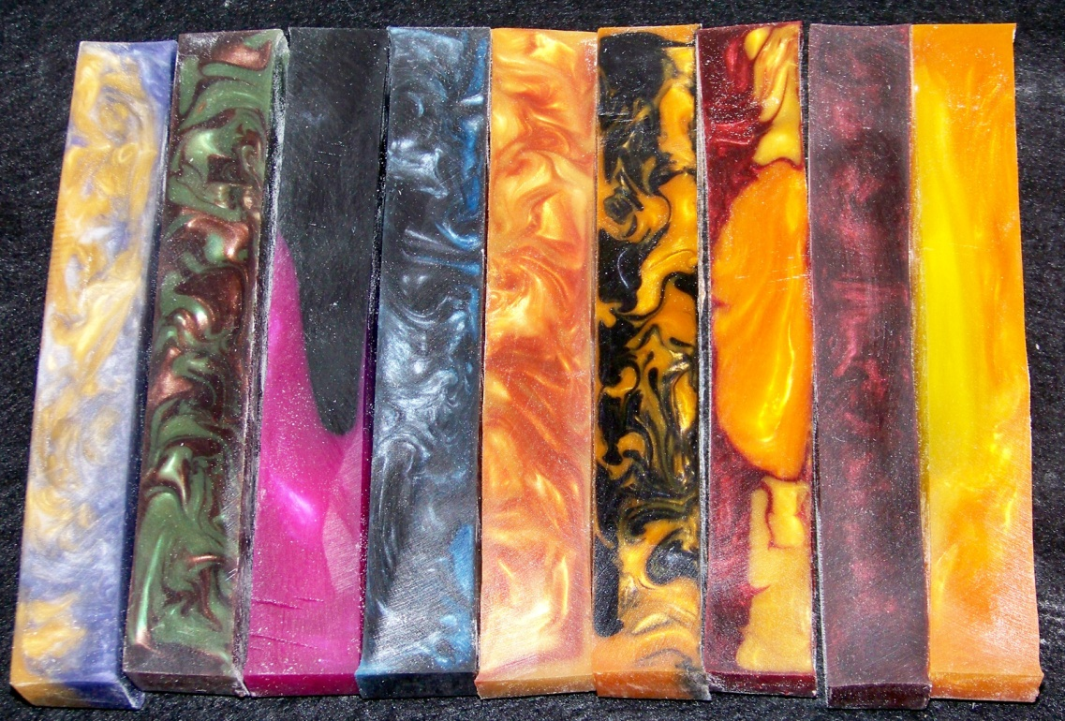
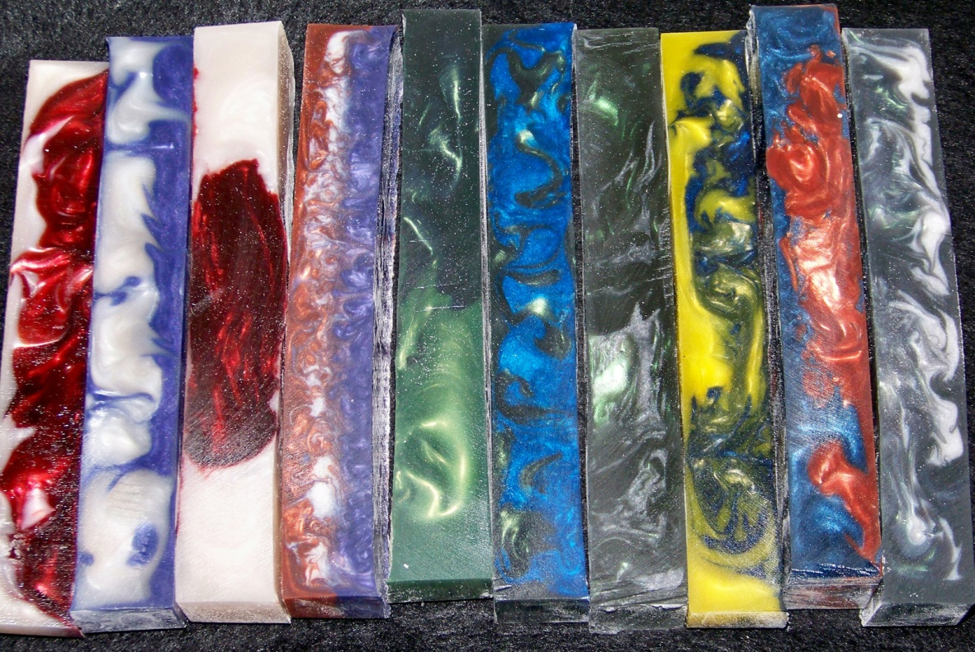
Acrylic type:
Polyester Resin
Colorant: Mica Powders
Made by Jonathon Brooks
www.Pourmepenworks.com
(online June 2010)
IAP user name: Brooks803
Email:
Jonathon
@pourmepenworks.com

Slide 9
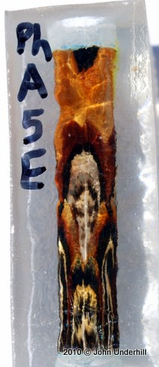
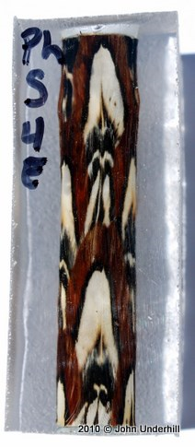
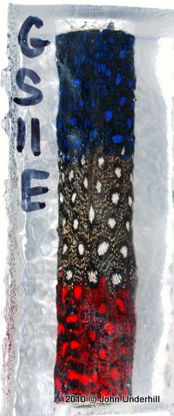
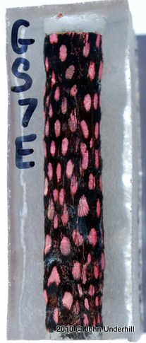
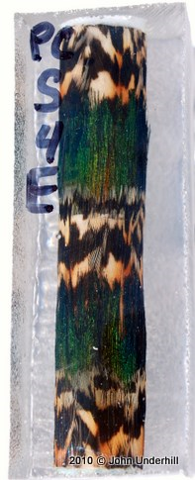
Acrylic type:
Polyester Resin
with feathers embedded
The Fantastic Feather© blanks Made by John Underhill
Sold exclusively by Exotic Blanks via their website:
http://www.exoticblanks.com

Slide 10
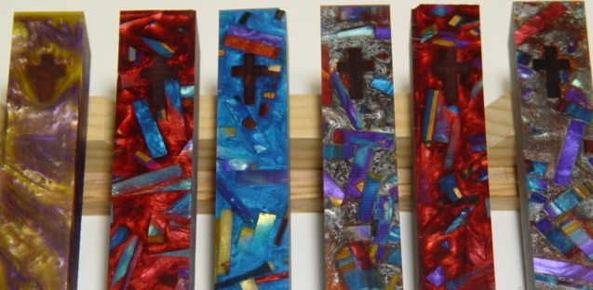
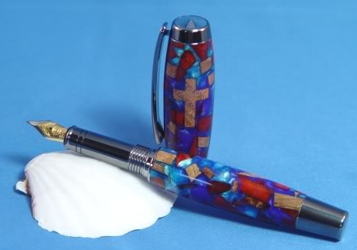
Acrylic type:
Alumilite
Amalgum Mutt blank
Made by Eugene Soto
Sold in the classifieds on IAP:
http://www.Penturners.org
Colored resin chips
and slices

Slide 11
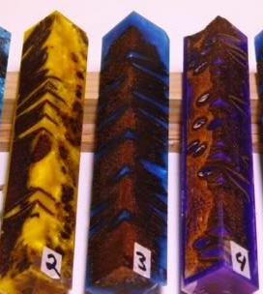
COFFEE BEANS
PASTA
COLORED RESIN CHIPS & SLICES
ACORNS
BURL CAPS
BANKSIA PODS

Slide 12
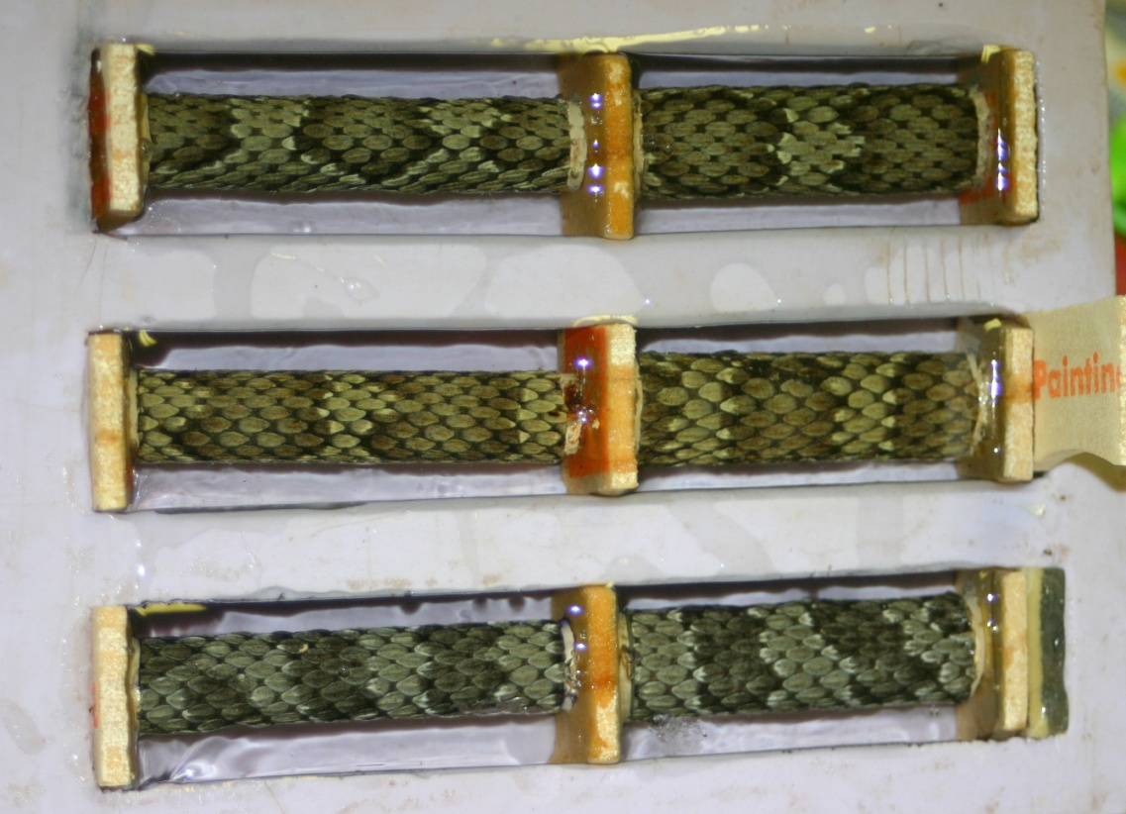
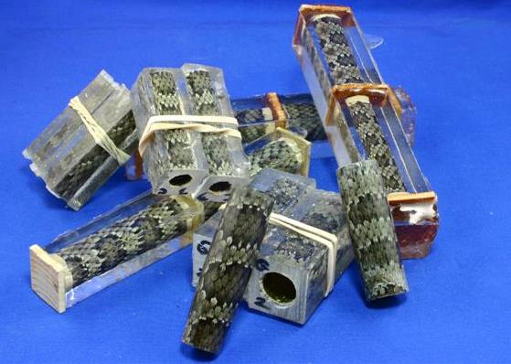
Snake and stamp
blanks by Don Ward

Slide 13
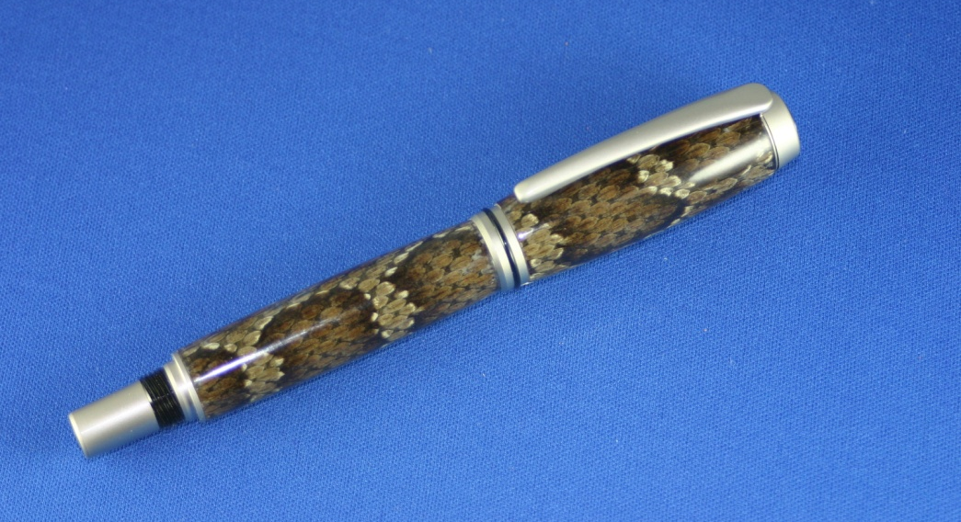
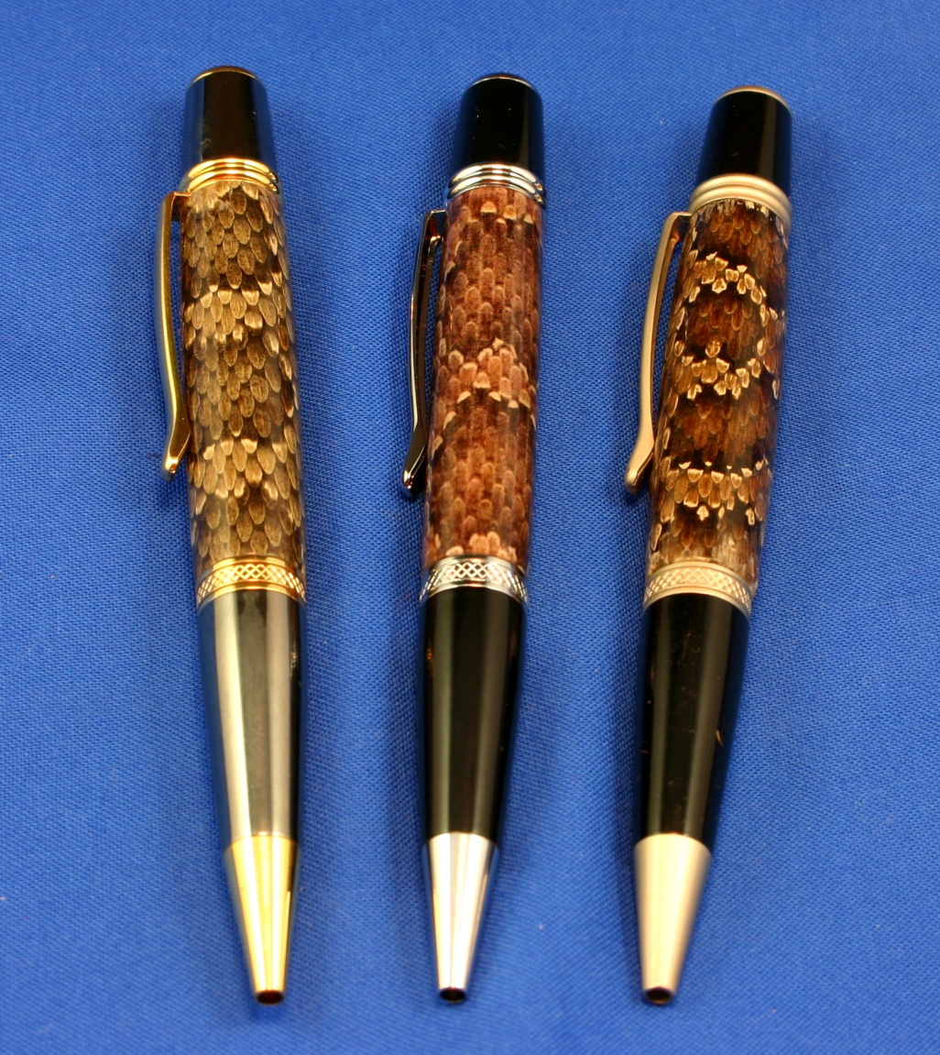
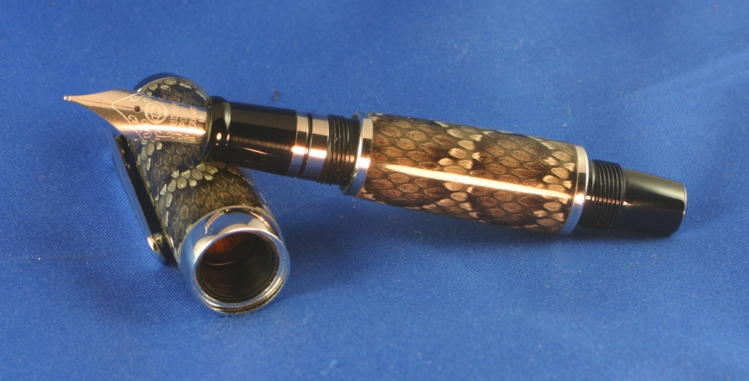
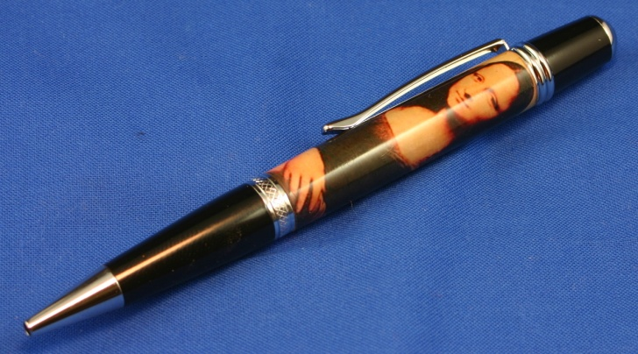
Real or Memorex? Two are real
skins and one is a computer label.
Mona Lisa blank
By Bruce Robbins

Slide 14
COLORED BLANKS
best article:
outlines how to cast colored polyester resin
written by Richard Greenwald
http://www.richardlgreenwald.com/docs/
CASTING%20POLYESTER%20RESIN.pdf
homemade blank & pen parts for custom pens
another excellent article: http://www.jaxturners.org /tech/
casting_with_polyester_resin.pdf
Google “casting polyester resin” and enough material will be found to keep you busy reading for hours.

Slide 15
Colored, dyed, and swirled blanks
Dyes come in:
Liquid and Powder
Opaque and Transparent
Plain - Pearl - Luster -
Fluorescent - Phosphorescent

Slide 16
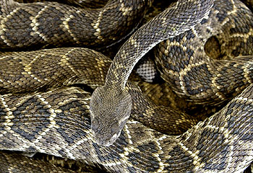
CASTING SNAKE SKIN BLANKS

Slide 17
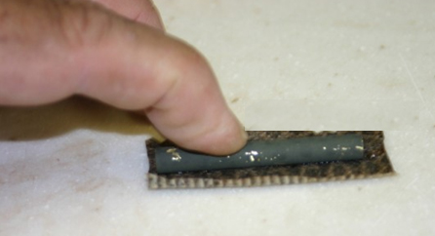
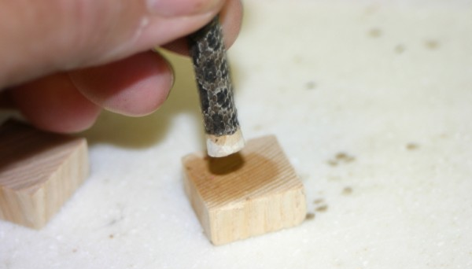
Not so thick!
I now use paint stirring sticks.

Slide 18
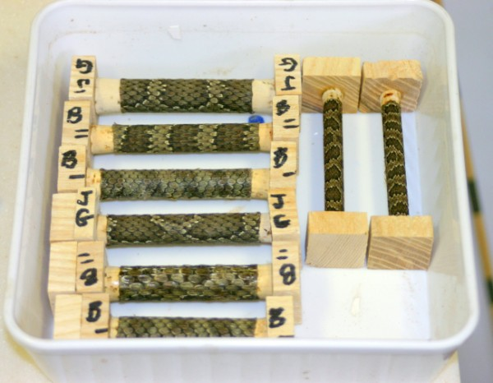
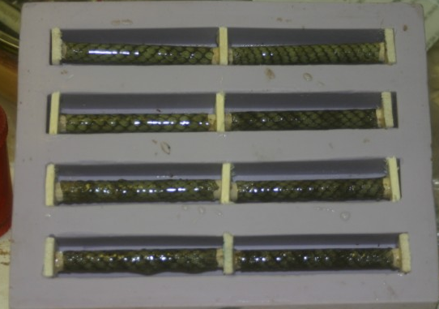
use small throw away brushes and paint raw
PR onto the skins as I put them into the mold.
stuff the tubes with play-dough . . .
. . . leaving enough room for corks or plugs.
Air is the ememy!

Slide 19
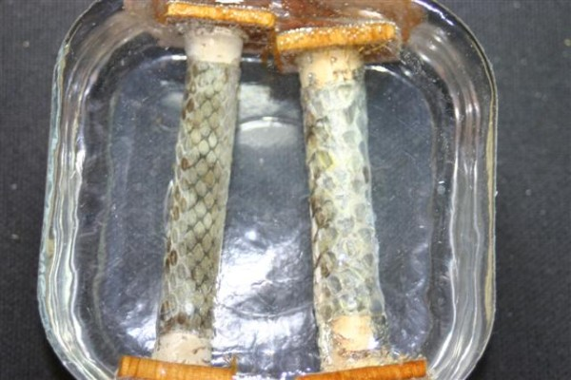
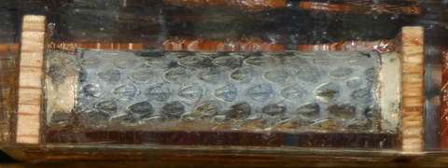
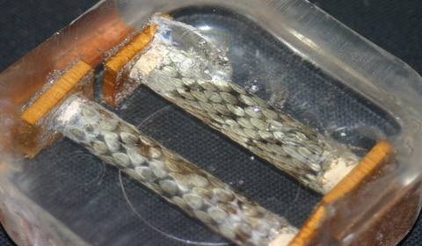
AND HEAT is the ememy!

Slide 20
Resin Saver Molds available from NewLondon88
on IAP . . . one mold perpen kit (kit specific)

Slide 21
Slot Type Molds available from gadget on IAP. These molds make blanks like we purchase.
They come in 5/8, 3/4 and 7/8 inch widths.

Slide 22
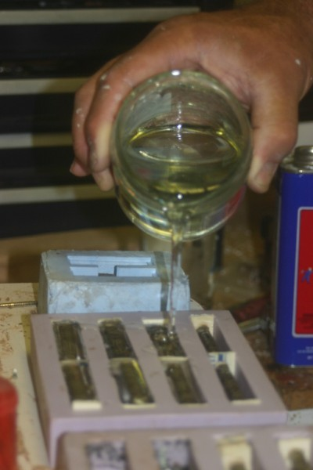
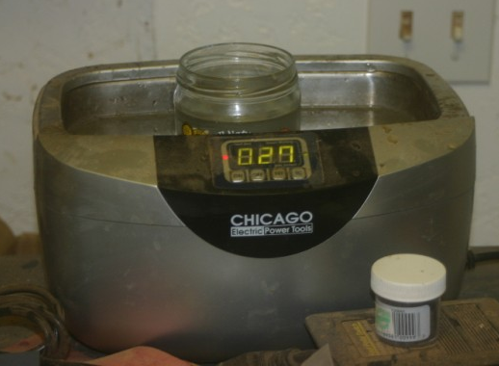

Slide 23
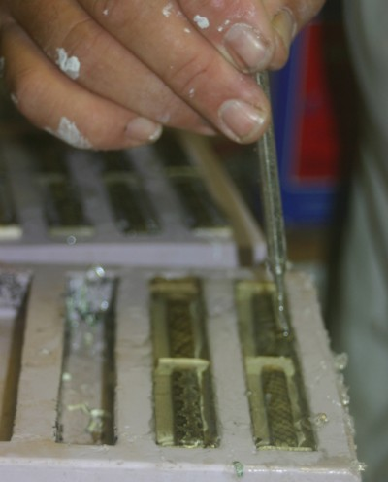

Slide 24
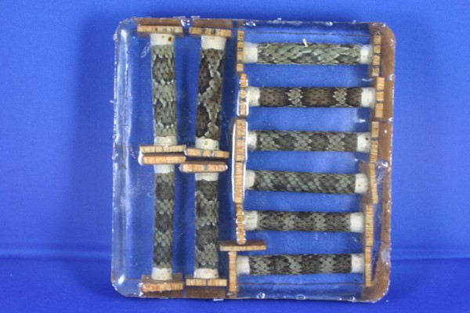

Slide 25
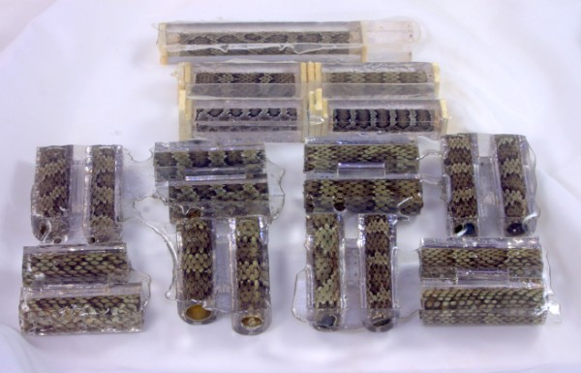

Slide 27
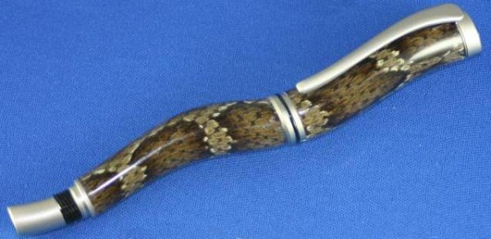
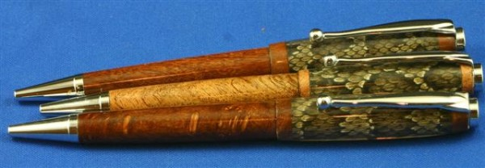

Slide 28
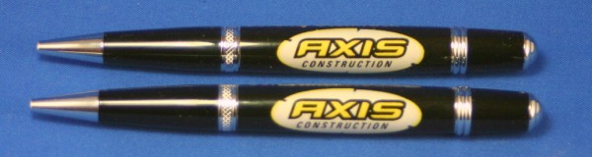
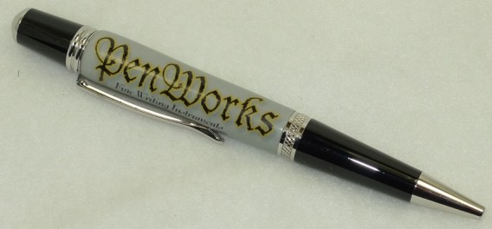
CASTING COMPUTER LABELS BLANKS

Slide 29
These individual labels are created in Adobe Photoshop. Other graphic editing software are available in the market. A free software Gimp is available from: http://www.gimp.org
Calculate the size of the
label for the kit
Build the label placing
each element of the
graphic on a separate layer
Manipulated layers for the best artistic placement.
Merge layers to flatten image as a .jpg

Slide 30
Copy finished graphic to new 8 1/2 x 11

Slide 31
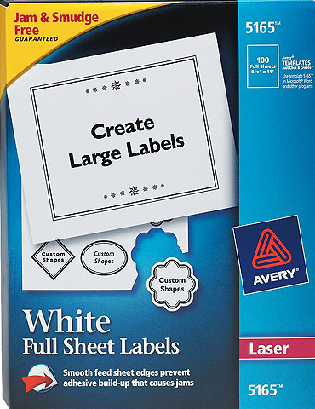
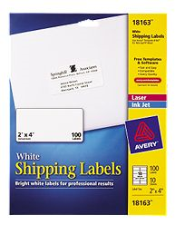
Avery #18163
2” x 4” or
Avery #5165
full sheet Labels.
Other brands may work but some
turners complain about labels
lifting off the tubes.
I’ve had no label
failures using Avery labels.

Slide 32
PREPARE THE TUBE:
For labels
use
white spray
primer.
For snake skins
use
deep forest
green
ultra flat
LET DRY FOR 24 - 48 HOURS

Slide 33
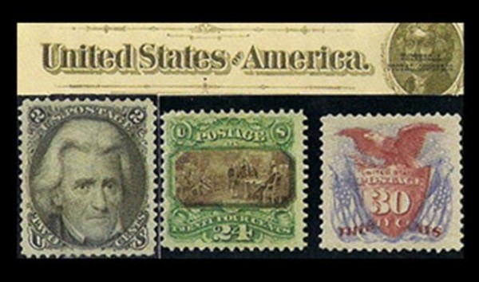
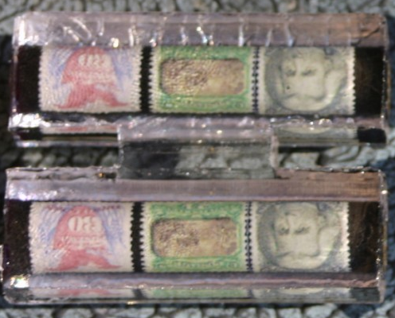
Stamp images were copied from the internet. Real stamps can be used or scanned.

Slide 34
TIPS FOR TURNING ACRYLICS
Sharp tools
Light cuts
Remove corners with band saw or
disk sander
Use your favorite tool.
Gouges may be a bit aggressive.
Roughout gouge to round the blank
Skew to take it down
Round nose scraper to completion

Slide 35
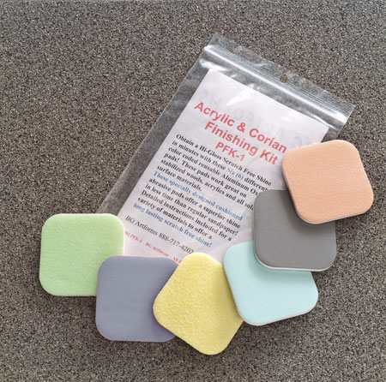
TIPS FOR TURNING ACRYLICS
Sand 320 to 400
Wet sand with micromesh
Wet sand with Acrylic and Polishing kit

Slide 36
Acrylic and Polishing Kit
There are 6 different
abrasive grits:
600 800 1,500 2,400
4,000 and 12,000
C
Micro Mesh
The ultimate fine abrasive.
This special cloth/rubber based "sandpaper" goes to 12,000 grit. Each package contains (9)
4" x 3" and a special rubber pad.
Grits are 1500 to 12,000.

Slide 37
Buff with your favorite dry
or liquid buffing compound
HUT UltlraGloss Plastic Polish
Tripoli and White Diamond
NOVUS Plastic polishing kit
FLITZ

